Slide 1


Santosh Kumar Kar,
skkar.2k2@gmail.com

Slide 2
CHAPTER – 6
Spring and Transaction
Santosh Kumar Kar
skkar.2k2@gmail.com

Slide 3
What is Transaction?
Transaction
Logical unit of work that contains one or more SQL statements
An Atomic Unit
Either all committed (applied to the database) or all rolled back (undone from the database)
In oftware, all-or-nothing operations are called transactions

Slide 4
ACID properties
Atomicity
Consistency
Isolation
Durability

Slide 5
Atomicity
Either all of its operations are executed or none.
Should not be partially completed.

Slide 6
Consistency
Data is in a consistent state when a transaction starts and when it ends.
For example, in fund transfer the total value of funds in both the accounts same before and after the Tx.

Slide 7
Isolation
The intermediate state of a transaction is invisible to other transactions

Slide 8
Durability
The database should be durable enough to hold all its latest updates even if the system fails or restarts

Slide 9
Spring Transaction Support
Programmatic transaction
Declarative transaction

Slide 10
Persistent mechanism
Spring uses transaction support offered by the persistent mechanism such as
JDBC,
Hibernate,
JDO,
Third party JTA implementation for distributed (XA) transaction.

Slide 11
Springs transaction manager
Spring does not directly manage transactions.
It comes with a selection of transaction managers that delegate responsibility for transaction management to a platform-specific transaction implementation provided by either JTA or the persistence mechanism.
You need to choose the correct transaction manager as per your design.

Slide 12
Springs transaction manager
Transaction manager (org.springframework.*) | Use at
jdbc.datasource.DataSourceTransactionManager | Spring’s JDBC
jms.connection.JmsTransactionManager | JMS 1.1+.
jms.connection.JmsTransactionManager102 | JMS 1.0.2.
orm.hibernate.HibernateTransactionManager | Hibernate 2
orm.hibernate3.HibernateTransactionManager | Hibernate 3
orm.jpa.JpaTransactionManager | JPA
transaction.jta.WebLogicJtaTransactionManager | distributed transactions in WebLogic.
transaction.jta.WebSphereTransactionManagerFactoryBean | distributed transactions in WebSphere

Slide 13
Choosing between programmatic and declarative transaction management
Programmatic transaction management is usually a good idea only if you have a small number of transactional operations. For example, if you have a web application that require transactions only for certain update operations, you may not want to set up transactional proxies using Spring or any other technology. In this case, using the TransactionTemplate may be a good approach. Being able to set the transaction name explicitly is also something that can only be done using the programmatic approach to transaction management.
On the other hand, if your application has numerous transactional operations, declarative transaction management is usually worthwhile. It keeps transaction management out of business logic, and is not difficult to configure. When using the Spring Framework, rather than EJB CMT, the configuration cost of declarative transaction management is greatly reduced.

Slide 14
Programmatic Transaction

Slide 15
Spring Programmatic Transaction
Developers work with the Spring transaction abstraction
Good: Developer’s has full control over the transaction
Can choose if number of transactional operations are less
Bad:
It’s burden to developers

Slide 16
2 means of programmatic Tx Implementation
Using a PlatformTransactionManager implementation directly
Using the TransactionTemplate

Slide 17
Steps
In Spring config
Select appropriate TransactionManager for your application to inject into TransactionTemplate.
Select appropriate TransactionTemplate and inject into DAO class.
In DAO class:
Define the property for TransactionTemplate.
Call TransactionTemplate.execute() method,
implementing the TransactionCallback interface,
implement the method doTransaction() declared in TransactionCallback interface.

Slide 18
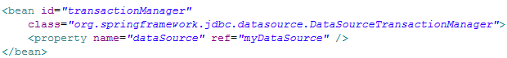
1. Config Tx Manager
Using DataSourceTransactionManager

Slide 19

2. Inject Tx Template to Dao class
org.springframework.transaction.support.TransactionTemplate

Slide 20
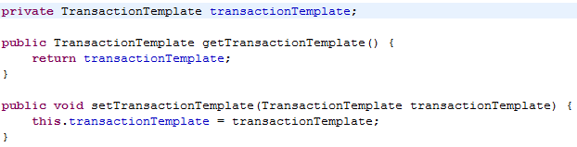
Declare tx template in DAO class

Slide 21
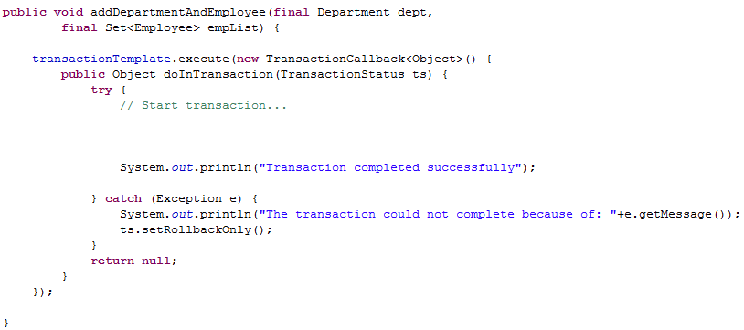
Write tx in DAO class
Your transaction

Slide 22
Declarative Transaction

Slide 23
Spring Declarative Tx
Helps to decouple an operation from its transaction rules.
Implemented through Spring’s AOP framework
Good when transactional operations are high

Slide 24
Spring Declarative Tx
3 ways to declare transactional boundaries
By proxying transaction using Spring AOP
Simple XML-declared transaction
Annotation-driven transactions.

Slide 25
dataSource & jdbcTemplate
<bean id="dataSource"
class="org.springframework.jdbc.datasource.DriverManagerDataSource">
<property name="driverClassName"
value="com.mysql.cj.jdbc.Driver" />
<property name="url" value="jdbc:mysql://localhost/learning" />
<property name="username" value="root" />
<property name="password" value="" />
</bean>
<bean id="jdbcTemplate"
class="org.springframework.jdbc.core.JdbcTemplate">
<property name="dataSource" ref="dataSource" />
</bean>

Slide 26
Transaction Manager
<!-- Tx Manager provided by Spring -->
<bean id="transactionManager"
class="org.springframework.jdbc.datasource.DataSourceTransactionManager">
<property name="dataSource" ref="dataSource"></property>
</bean>
If you are using global transactions, you must use theorg.springframework.transaction.jta.JtaTransactionManager class (or an application server-specific subclass of it)

Slide 27
Transaction Manager
<!-- This proxy bean is used in Client.java -->
<bean id="empAndDeptTxDao"
class="org.springframework.transaction.interceptor.TransactionProxyFactoryBean">
<property name="target" ref="txTarget"></property>
<property name="transactionManager" ref="transactionManager"></property>
<property name="proxyInterfaces"
value="com.learning.txAndProxy.EmployeeAndDepartmentTx"></property>
<property name="transactionAttributes">
<props>
<prop key="save*">PROPAGATION_REQUIRED</prop>
<prop key="*">PROPAGATION_SUPPORTS</prop>
</props>
</property>
</bean>

Slide 28
Dao class for Tx
public class EmployeeAndDepartmentTransactionImpl implements EmployeeAndDepartmentTx {
private JdbcTemplate jdbcTemplate;
public void setJdbcTemplate(JdbcTemplate jdbcTemplate) {
this.jdbcTemplate = jdbcTemplate;
}
public void saveDepartmentAndEmployee(Department dept, Employee emp) {
saveEmployee(emp);
saveDepartment(dept);
// throw new RuntimeException("Transaction cancelled");
}
}

Slide 29
Propagation Behavior
Propagation behavior defines the boundaries of the transaction with respect to the client and to the method being called.
Spring defines seven distinct propagation behaviors. These are the constants which you can find in Interface TransactionDefinition.

Slide 30

Propagation levels (Fields) in Spring
public enum Propagation extends Enum<Propagation>
MANDATORY
REQUIRED
NEVER
NOT_SUPPORTED
REQUIRED
REQUIRED_NEW
SUPPORTS

Slide 31
MANDATORY
Support a current transaction, throw an exception if none exists.

Slide 32
NESTED
Execute within a nested transaction if a current transaction exists, behave like REQUIRED otherwise

Slide 33
NEVER
Execute non-transactionally, throw an exception if a transaction exists

Slide 34
NON_SUPPORTED
Execute non-transactionally, suspend the current transaction if one exists

Slide 35
SUPPORTS
Support a current transaction, execute non-transactionally if none exists

Slide 36
ISOLATION LEVELS
What is isolation level
how much a transaction may be impacted by the activities of other concurrent transactions.
In a typical application, multiple transactions run concurrently, often working with the same data to get their job done.

Slide 37
Explaining Isolation Level
For example, in the EMP table, the query is run to updated salary of Jack from 4000 to 5000.
UPDATE emp SET sal=5000 WHERE name='Jack';
But here the it is waiting to commit/rollback the transaction.
Now in another transaction, it run the query to read the salary of Jack as:
SELECT sal FROM emp WHERE name='Jack';

Slide 38
Explaining Isolation Level
Now the question is, when the 2nd person read before the commit: how much it should print?
the committed value 4000 ?
OR
the uncommitted value 5000 ?

Slide 39
Explaining Isolation Level
Answer: Depending on the Isolation level.
When set TRANSACTION_READ_UNCOMMITTED,
It’s the uncommitted value – 5000
When set TRANSACTION_READ_COMMITTED,
It’s the committed value – 4000.

Slide 40
Isolation levels (Fields) in Spring
public enum Isolation extends Enum<Isolation>
DEFAULT
READ_COMMITTED
READ_UNCOMMITTED
REPEATABLE_READ
SERIALIZABLE

Slide 41
DEFAULT
Use the default isolation level of the underlying datastore

Slide 42
READ-COMMITTED
A constant indicating that dirty reads are prevented; non-repeatable reads and phantom reads can occur.

Slide 43
READ-UNCOMMITTED
A constant indicating that dirty reads, non-repeatable reads and phantom reads can occur

Slide 44
REPEATABLE_READ
A constant indicating that dirty reads and non-repeatable reads are prevented; phantom reads can occur

Slide 45
SERIALIZABLE
A constant indicating that dirty reads, non-repeatable reads and phantom reads are prevented

Slide 46
Isolation Levels
Isolation Level | Dirty Reads | Non-Repeatable Reads | Phantom Reads
ISOLATION_READ_COMMITTED | Prevented | Allowed | Allowed
ISOLATION_READ_UNCOMMITTED | Allowed | Allowed | Allowed
ISOLATION_REPEATABLE_READ | Prevented | Prevented | Allowed
ISOLATION_SERIALIZABLE | Prevented | Prevented | Prevented

Slide 47
Other Transactional Attributes
readOnly — whether the transaction is read-only or read/write
timeout — transaction timeout
rollbackFor — arrays of exception class objects that must cause a rollback of the transaction
rollbackForClassName — arrays of exception class names that must cause a rollback of the transaction
noRollbackFor — arrays of exception class objects that must not cause a rollback of the transaction
noRollbackForClassName — arrays of exception class names that must not cause a rollback of the transaction

